Slide 1
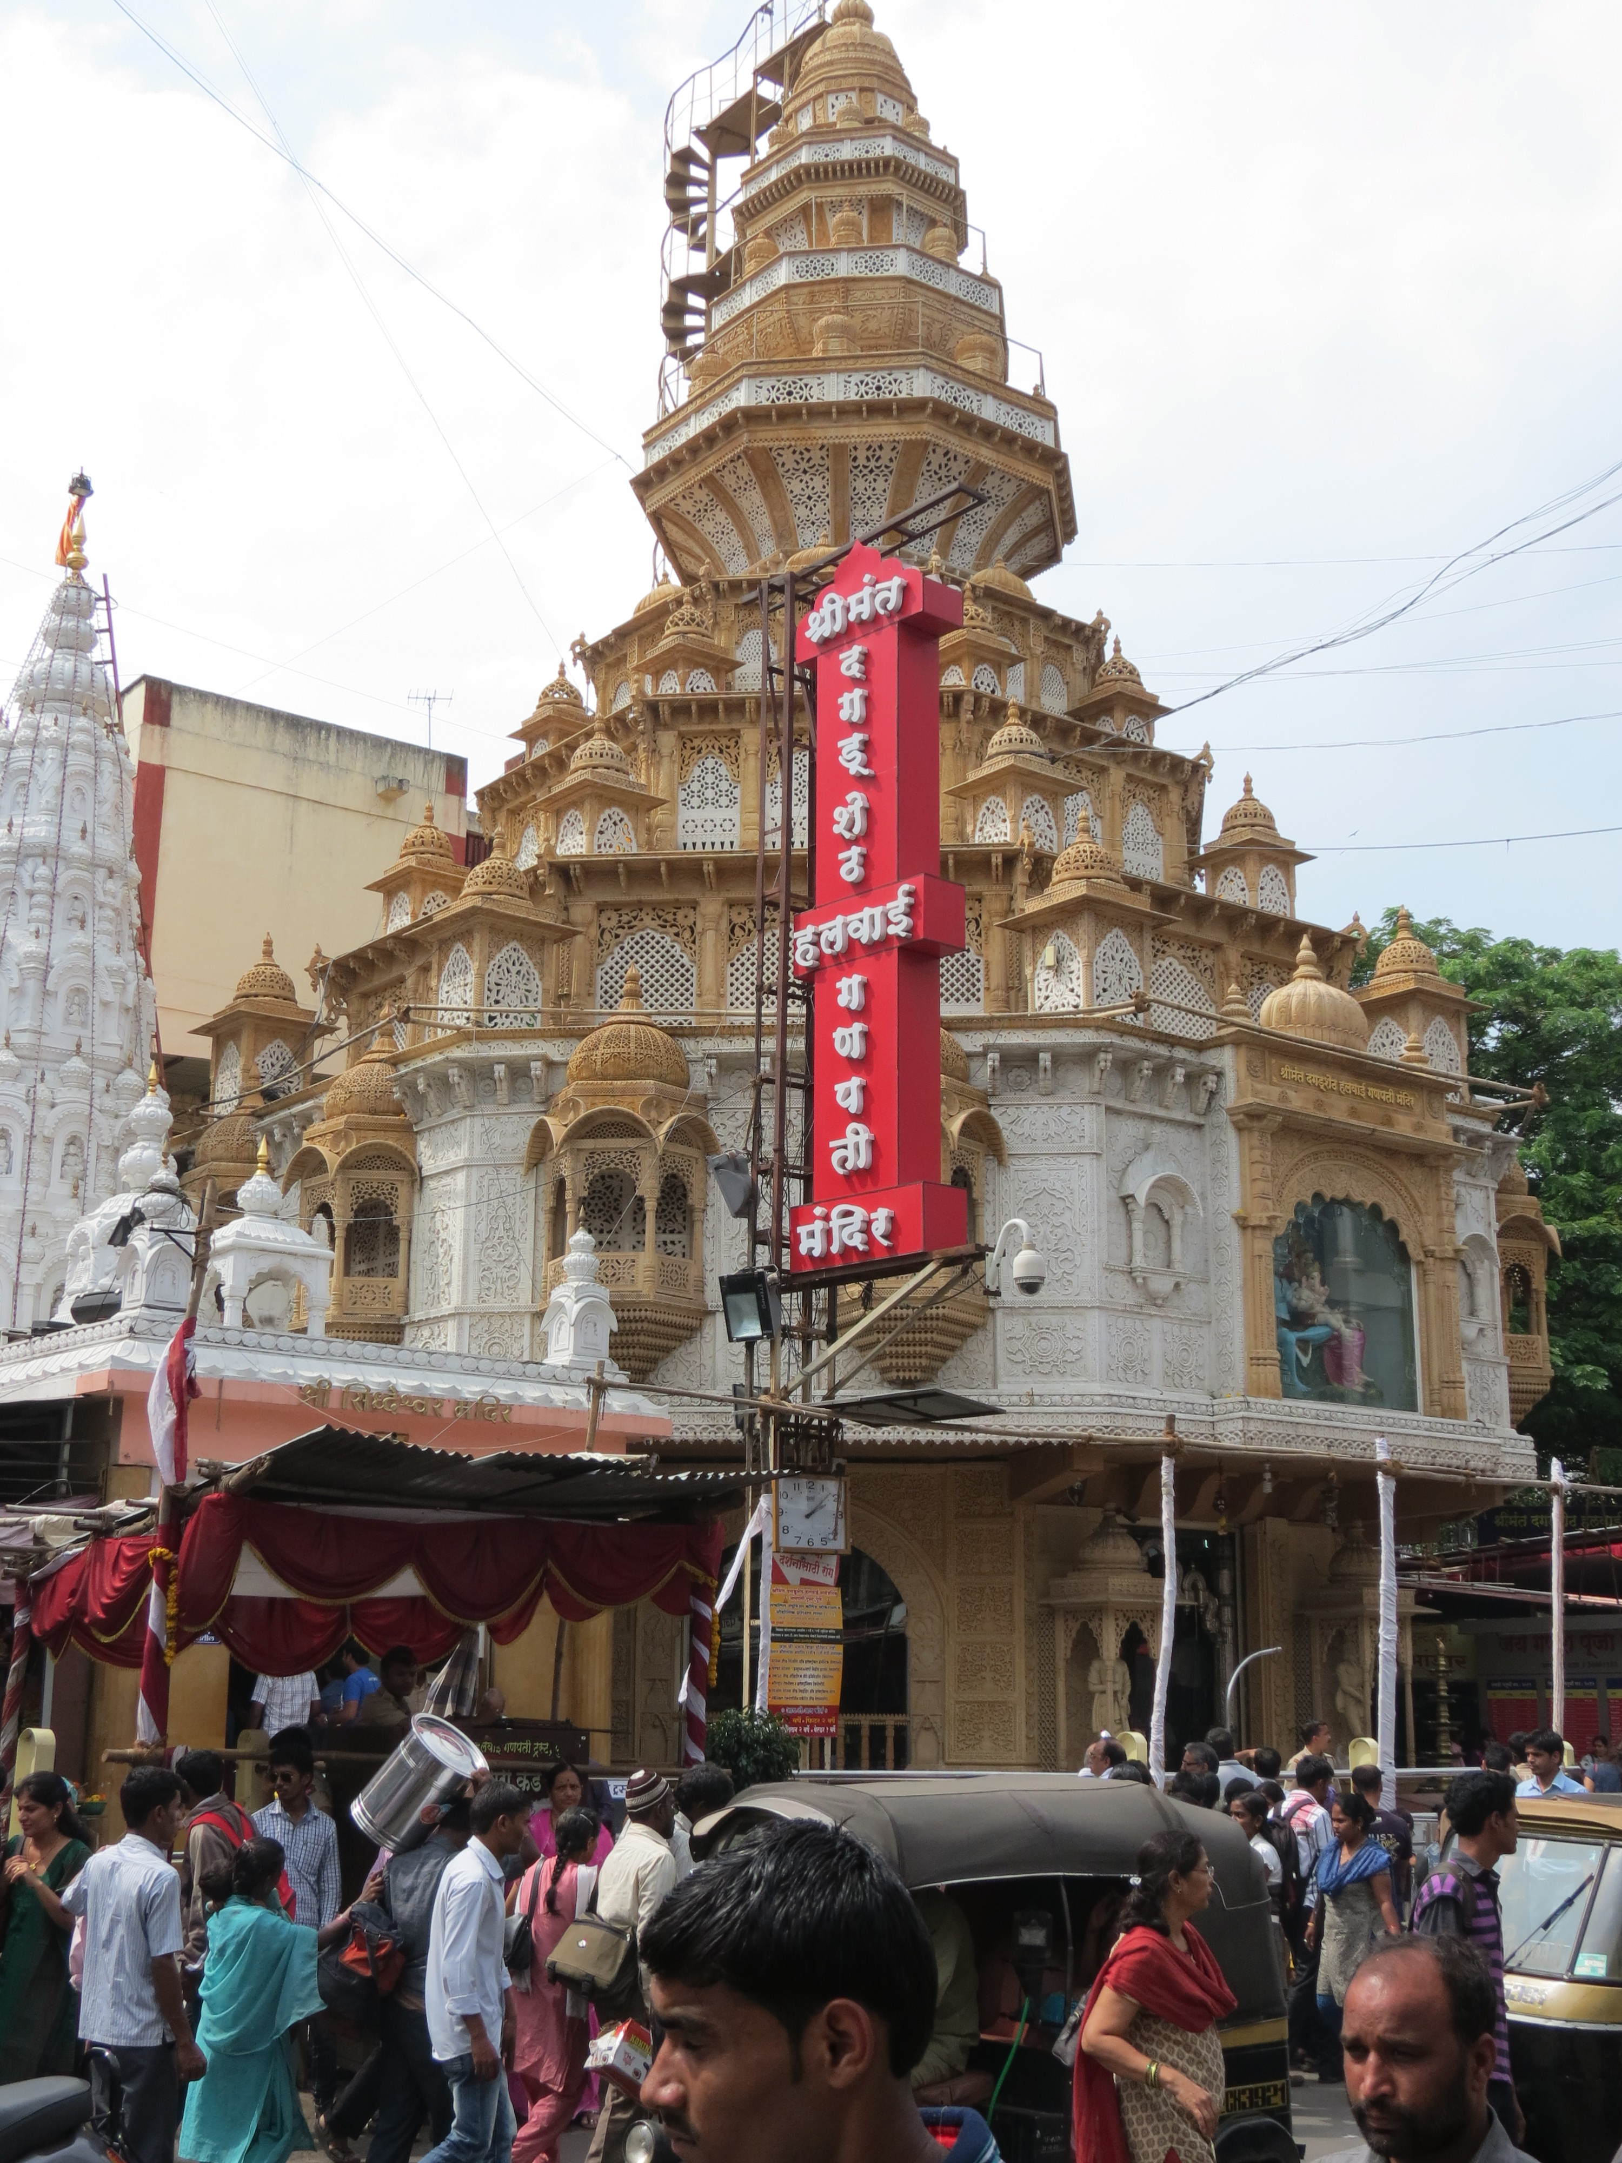
Pbl Project
FLIEGEN-TOURIST SPOT FINDER

Slide 2
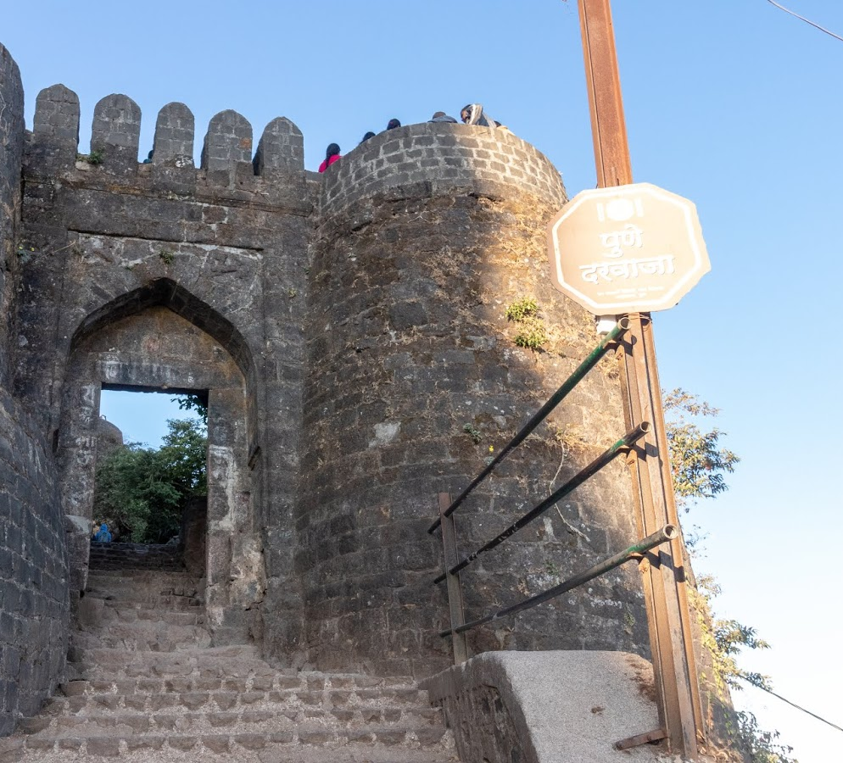
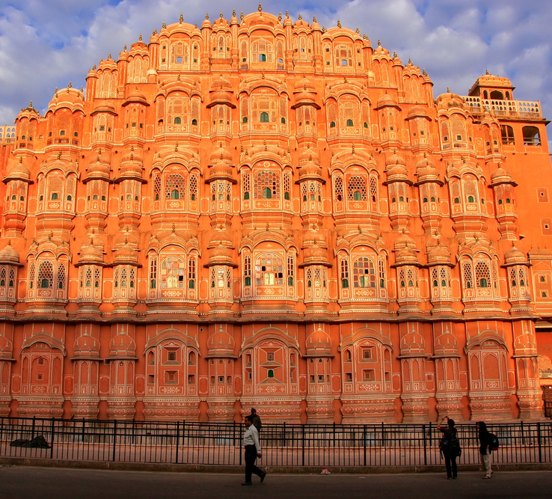
Agenda
Introduction​
Objective
Glimpse
Summary​

Slide 3

Introduction
Travelling and roaming around is in the top of bucket list of most of the people in the world. But when it comes in real, people are not able to decide the best spots or places to visit. This was the main inspiration of this project as we wanted to help people to get the list of best places in one tap and help them plan their tour efficiently.

Slide 4
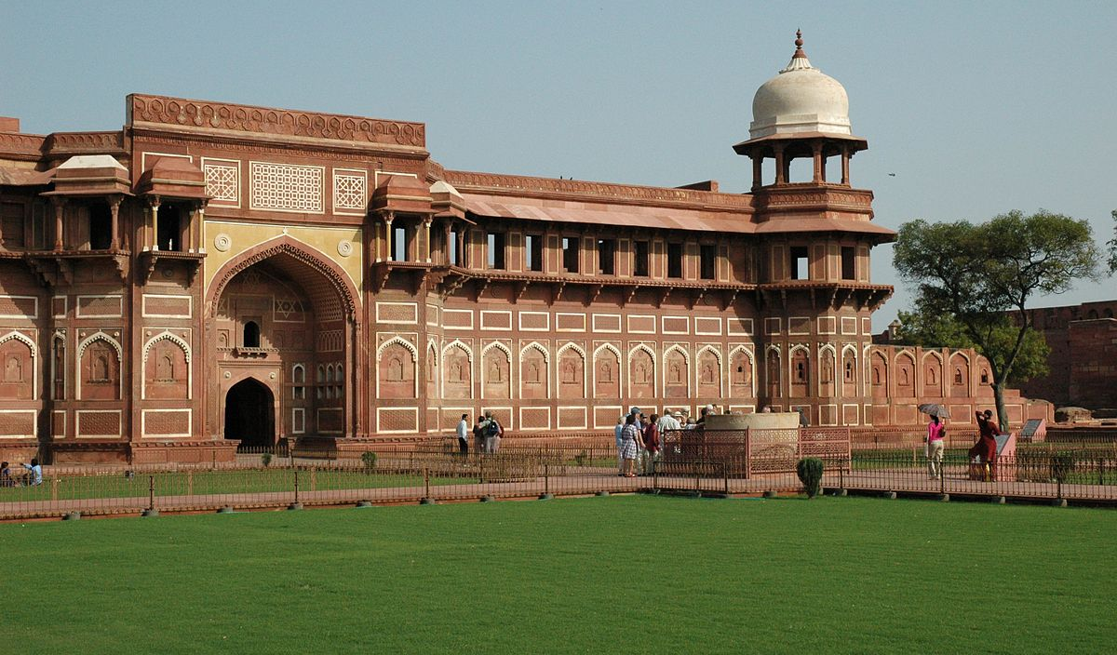
Objectives

Slide 5
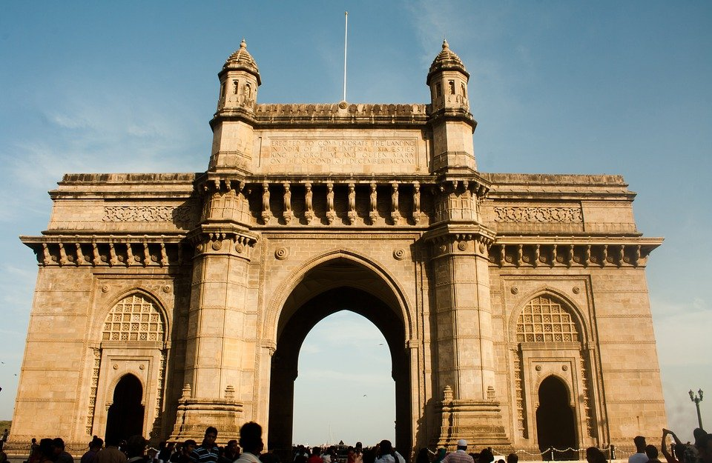
1.Making tourist places easily searchable and accessible.
2.Showing weather conditions to make planning feasible.
3.Recommending spots according to user interest.
4.Website designed such that, anyone can use it.
5.Along with showing the location, we also help guiding the traveler to reach that spot.

Slide 6
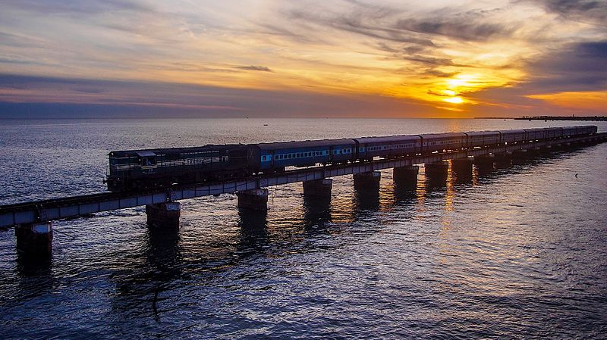
glimpse

Slide 7
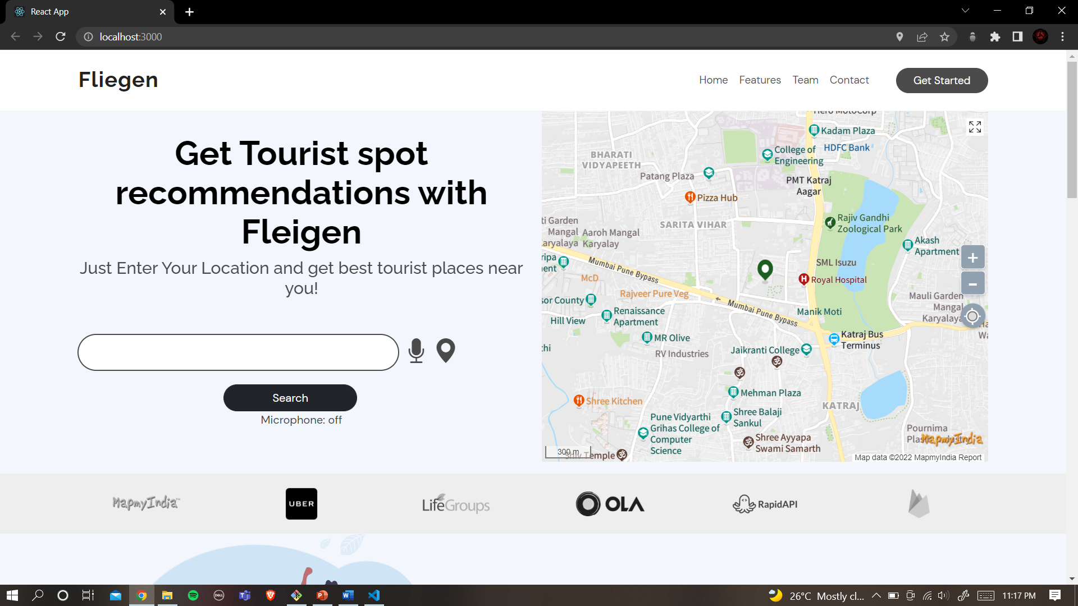
Home page

Slide 8
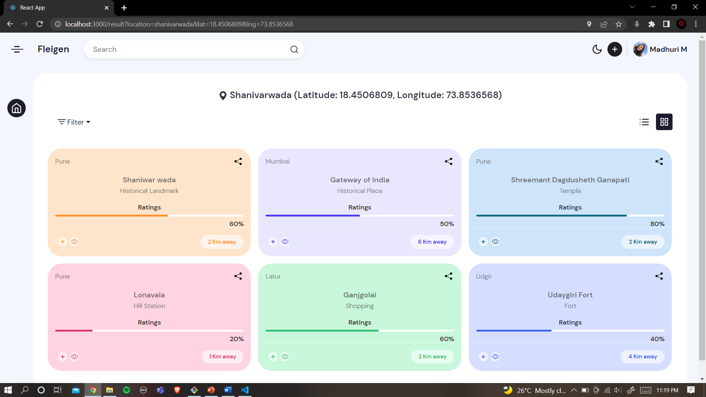
Search results

Slide 9
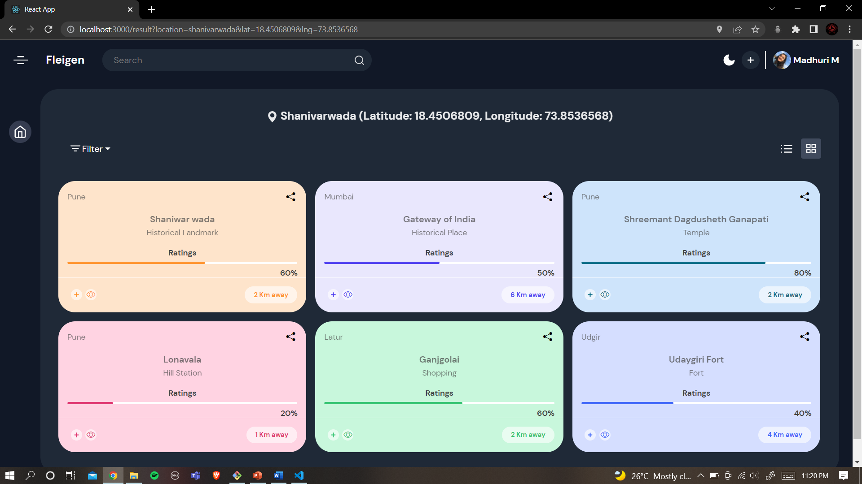
Dark mode

Slide 10
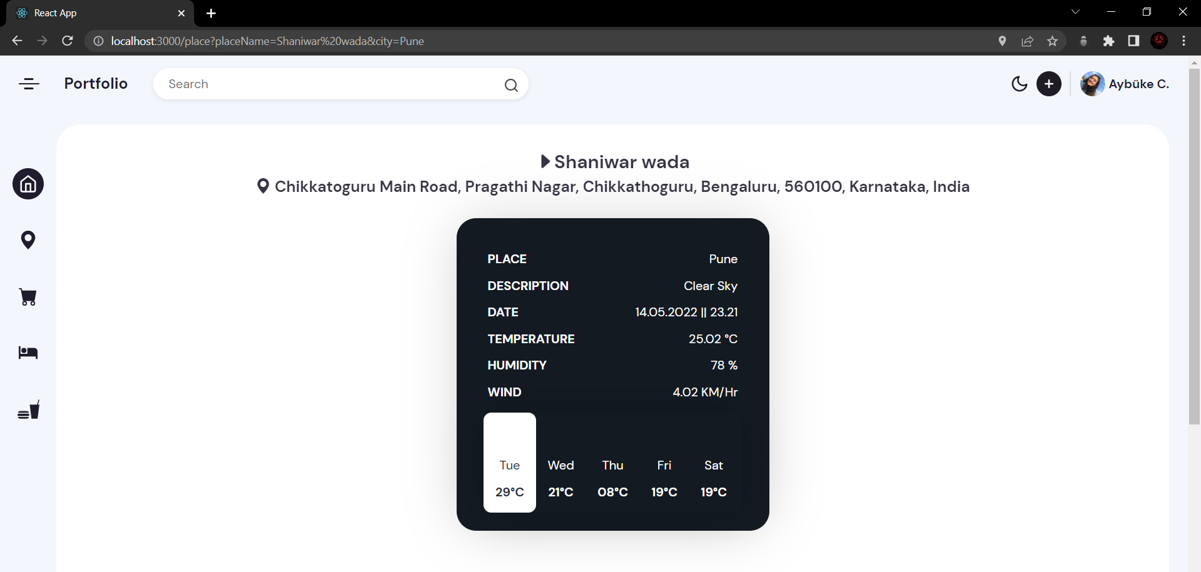
Place details with weather

Slide 11
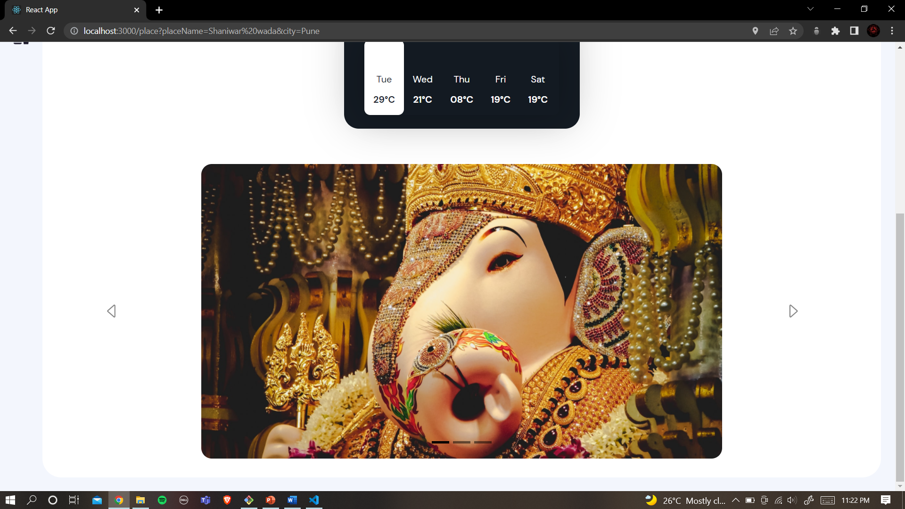
Image carousel

Slide 12
features
Easily Searchable and Accessible
Shows Weather Forecast and makes planning feasible
Get spot recommendations according to user interest
User Friendly
Helps travelers
navigate to the spot

Slide 13

Our Team
Sangmeshwar mahajan​​
Satyajeet more​​
Frontend + APIs
Frontend +Report
Madhur mundada​
Mihir parte​
Frontend + Synopsis​
Frontend + Report

Slide 14

Summary
This is one of the early iterations of our project. Many potentially useful functionalities can be added soon to make this website even useful.

Slide 15
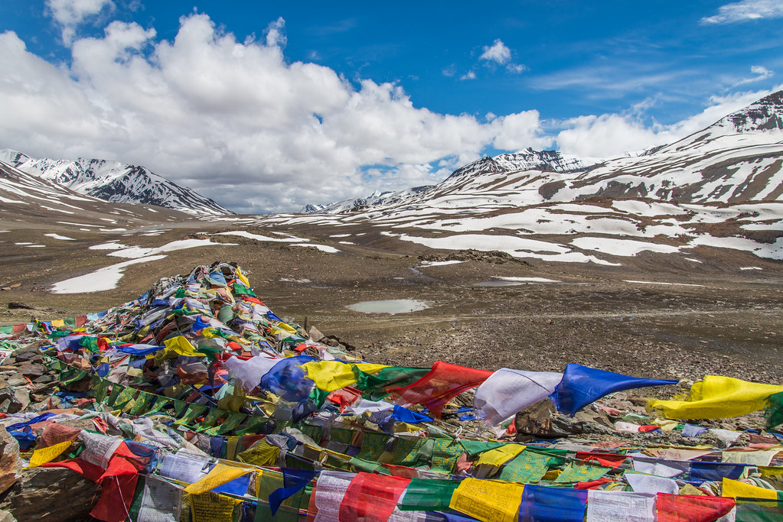
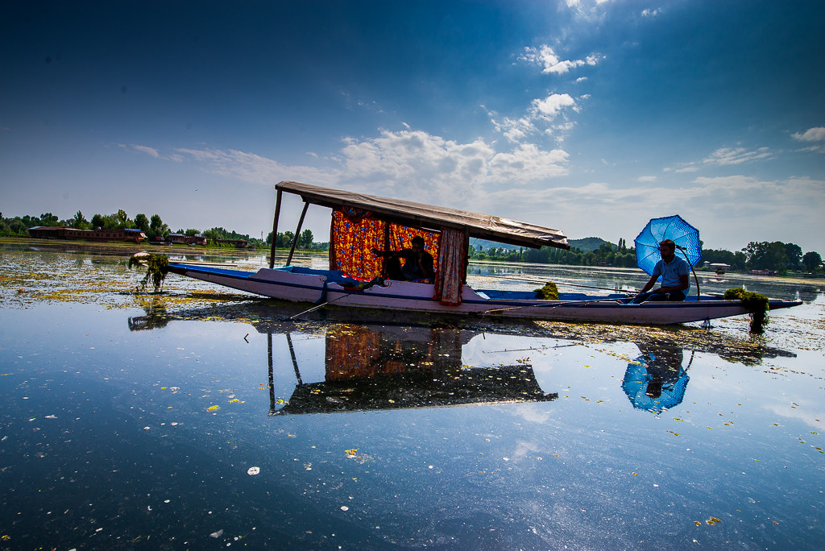
Thank you
Open to Suggestions:
svmore456@gmail.com
mahajansangmeshwar04@gmail.com
mihirparte13@gmail.com
madhurmundada01@gmail.com
​

